Slide 1
Synapse Link Pitch deck story mapping –Link for Dataverse
Problem
Solution
Azure Synapse Link
Data growing
Preparing data requires multiple processes
Processes create additional issues that stall data
Synapse datalink intro
Azure Synapse architecture
Data types are complex and growing
Relational
Business apps
Operational databases
Each data type requires individualized processes
Extract
Prepare
Load
Which creates more load and process - multiplying complexity problem
Process creates pipeline congestion for the analytics destination - data stalls in the process - slow for availability & analytics
Synapse datalink intro
Complex data types enabled with fluid connectivity and processing for analytics
Azure Synapse architecture
Single system - reduce burden for multiple systems
Right analytics engine for the right data at any scale
Security and governance
One-click experience for converged analytics
Solution
Differentiators
Case examples - patterns
How to - workspace
Azure Synapzse Link for Dataverse
Azure Synapse Link benefits
Common customer patterns SL for dataverse
Common customer patterns SL for dataverse
Synapse workspace Demo or Walkthrough
Synapse workspace video
Dataverse (Continued story from Azure Synapse link)
Removes barriers to insights
Extended analytics possibilities
One data destination
Give back valuable time
Reduce costs
V1
V2
Differentiator
Next Steps
Empower every data store to be analytics-ready
Enable Azure Synapse Link for converged analytics
Notes:
Resources:
L100 What is Azure Link for Dataverse?
https://microsoft-my.sharepoint.com/:v:/p/v-wralston/EaG99emHOB1Dle2hw20j6FEBKUhsJ126oQsuMNgffm2UdQ?e=xKUeuZ
To learn more about Azure Synapse Link for Dataverse: "Accelerate time-to-insight by connecting Dataverse and Azure Synapse Analytics."

Slide 2
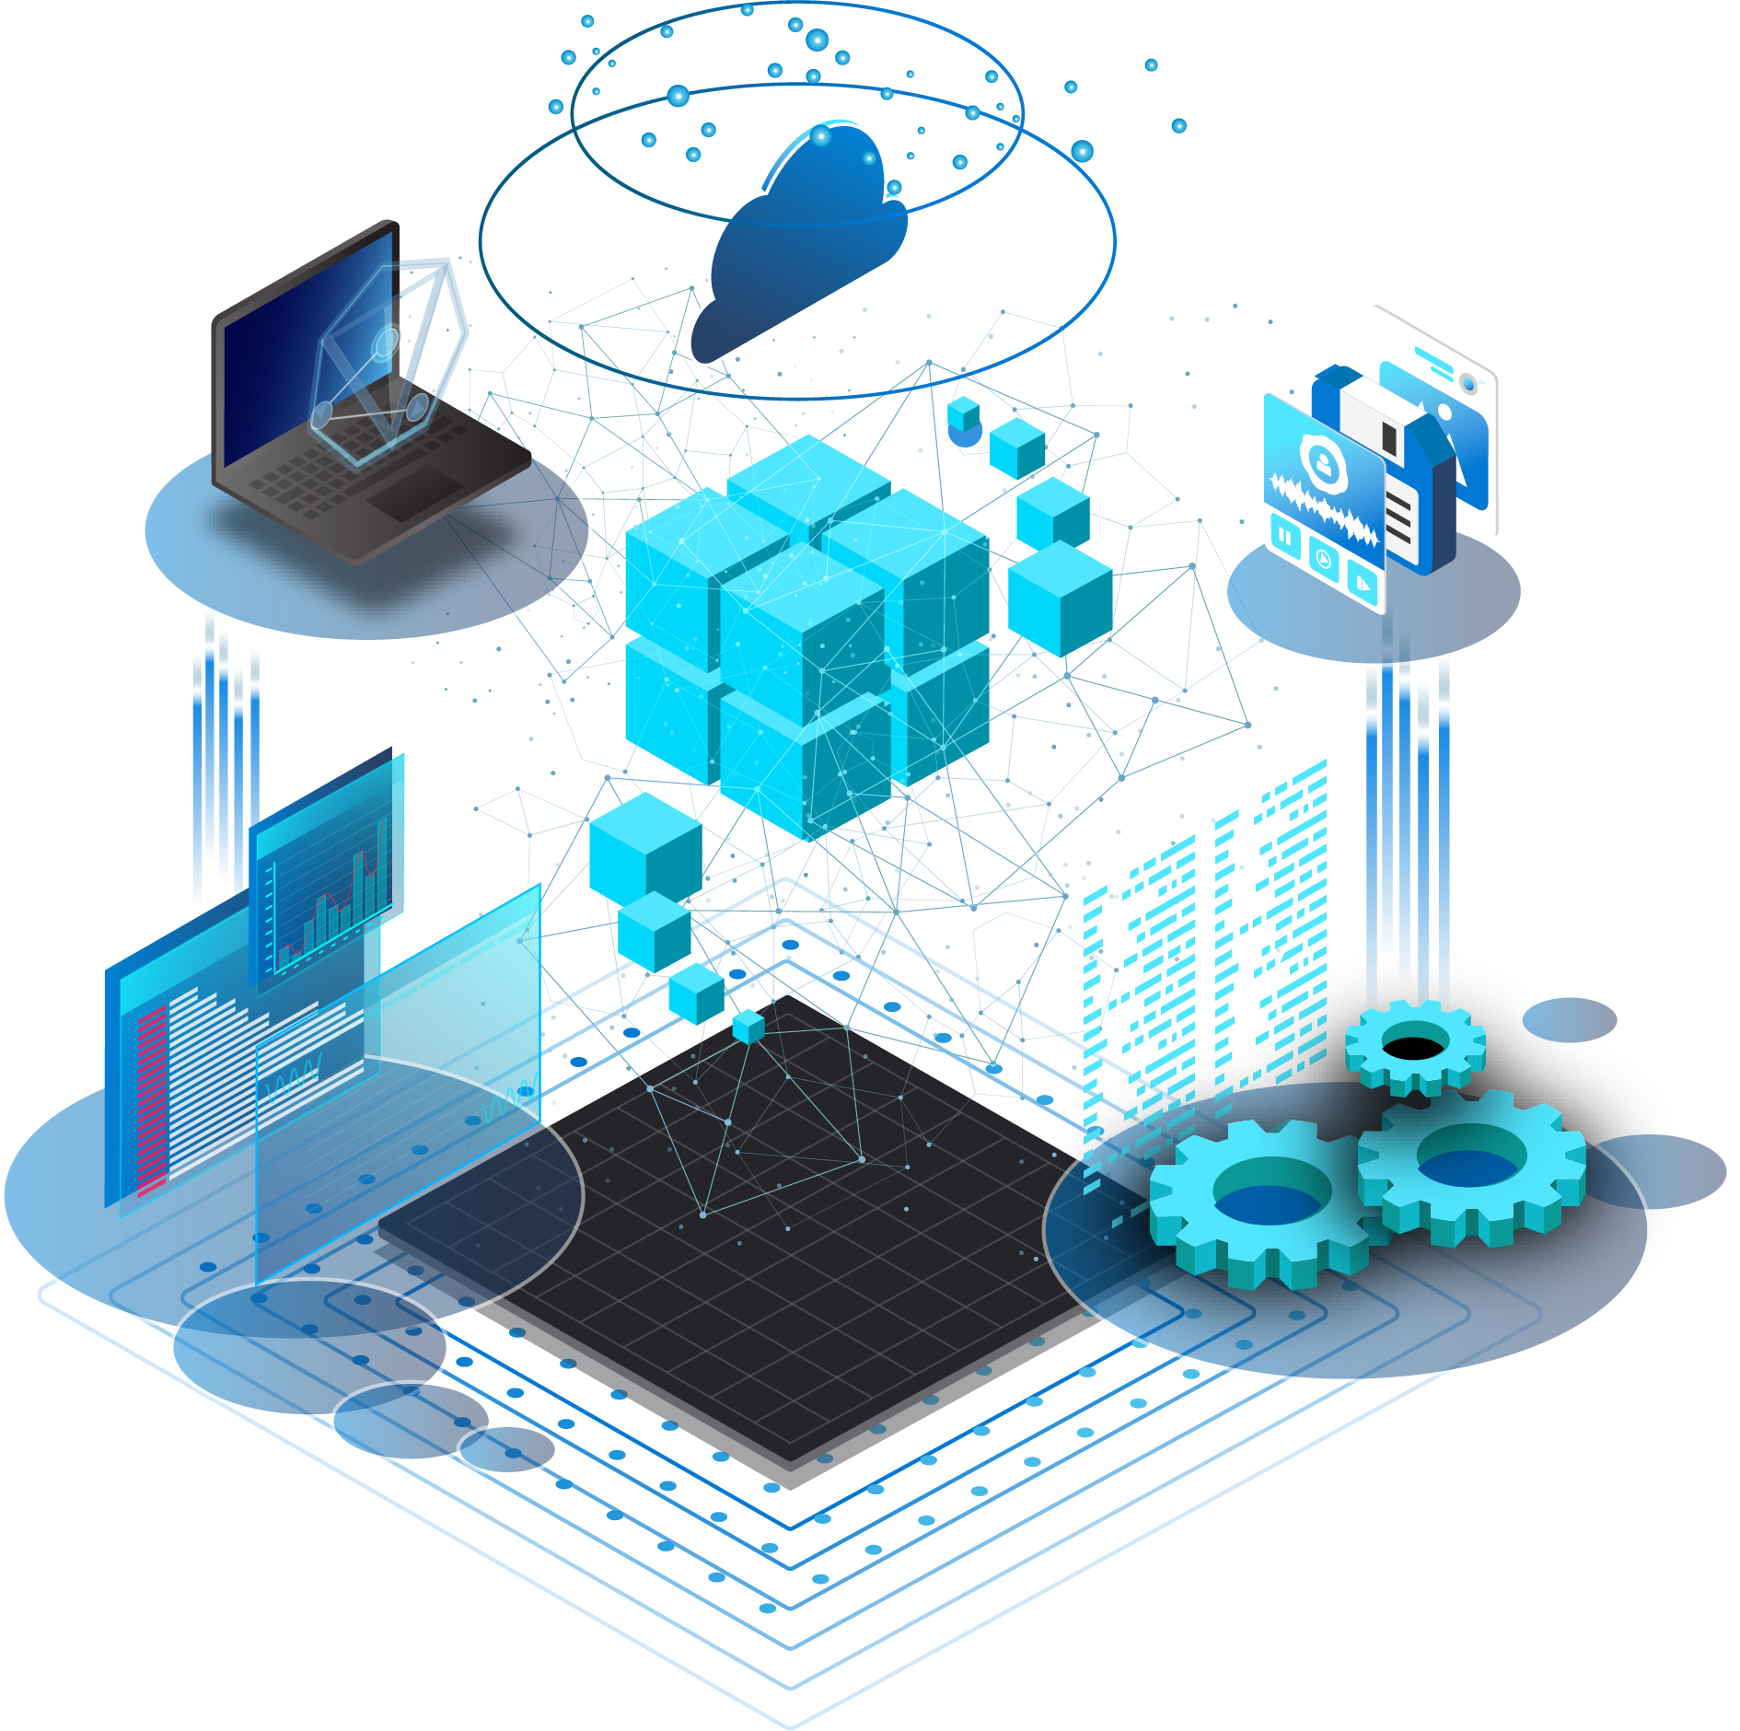
Removing Operational Barriers with Azure Synapse Link
Accelerate time to insight

Slide 3


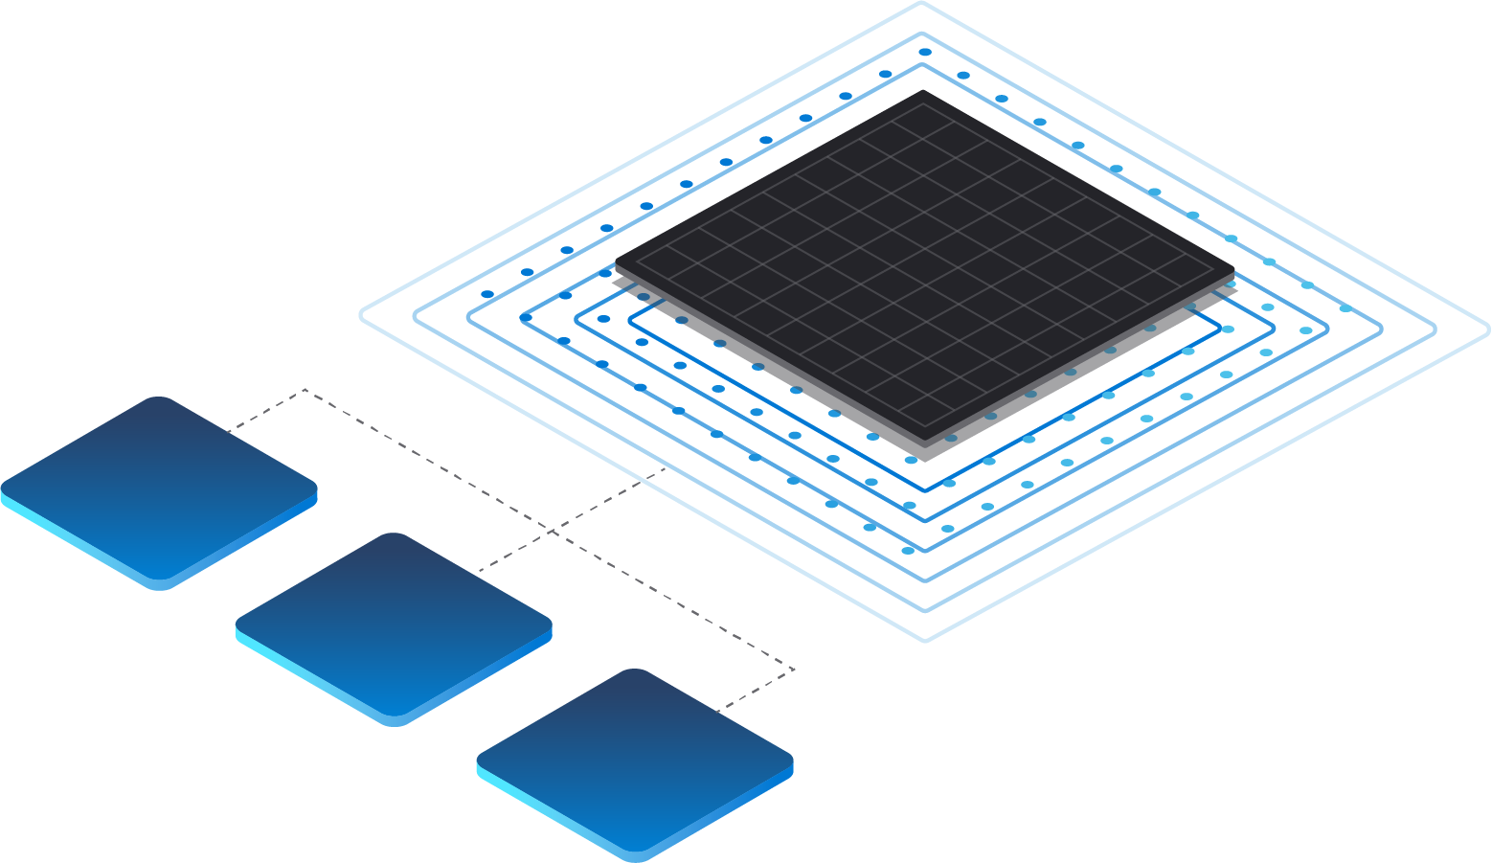
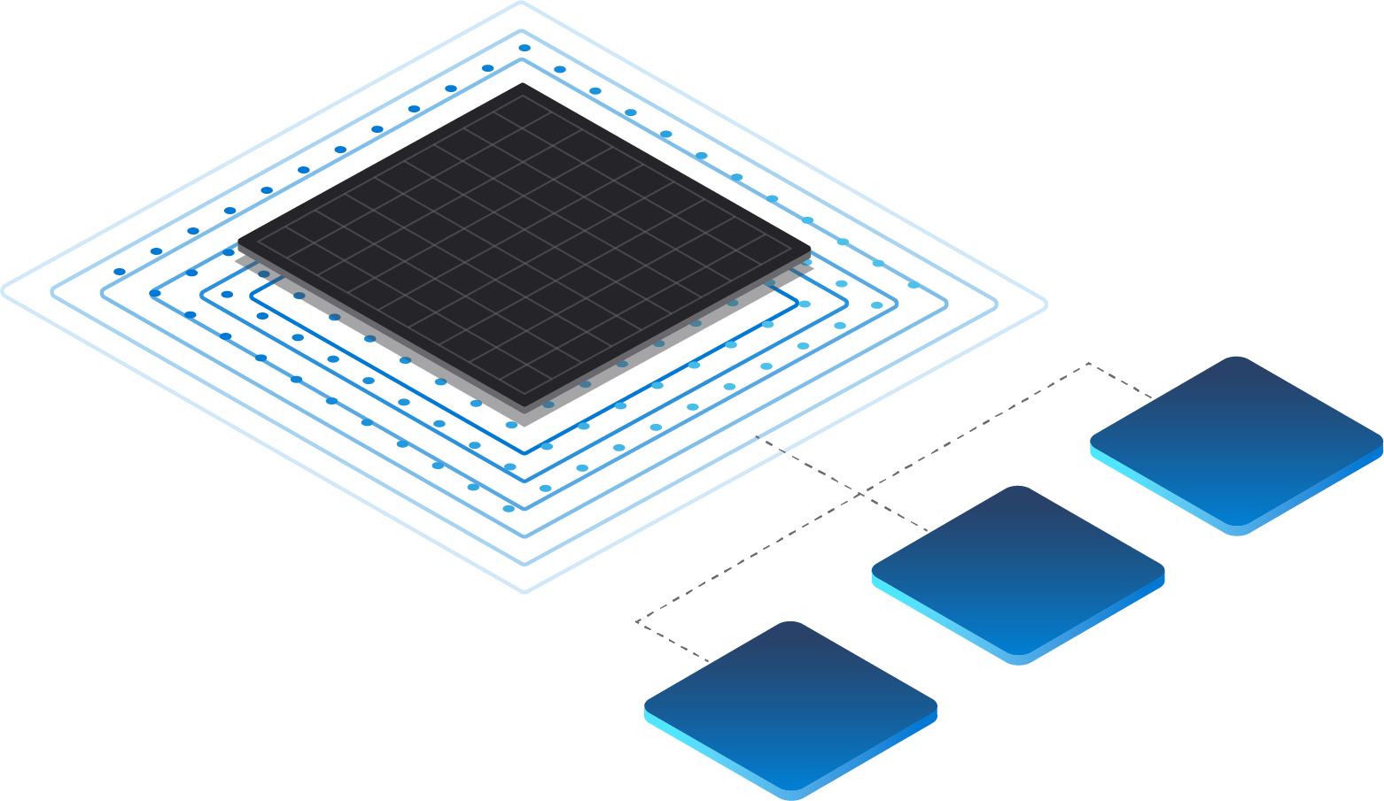
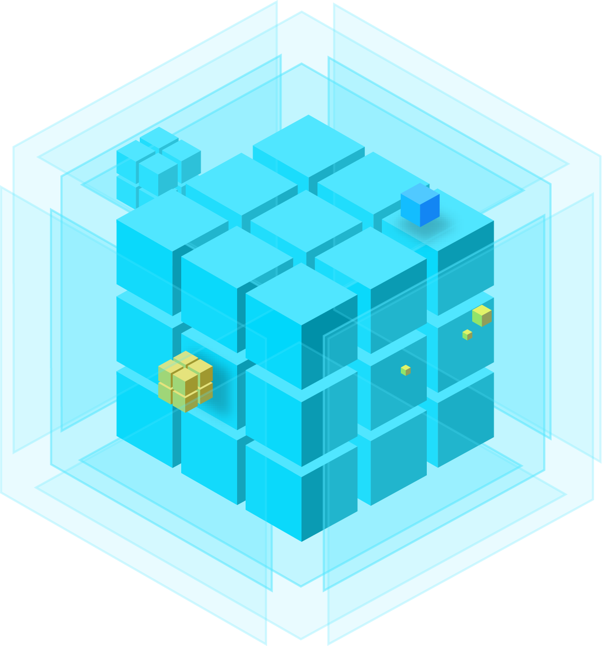

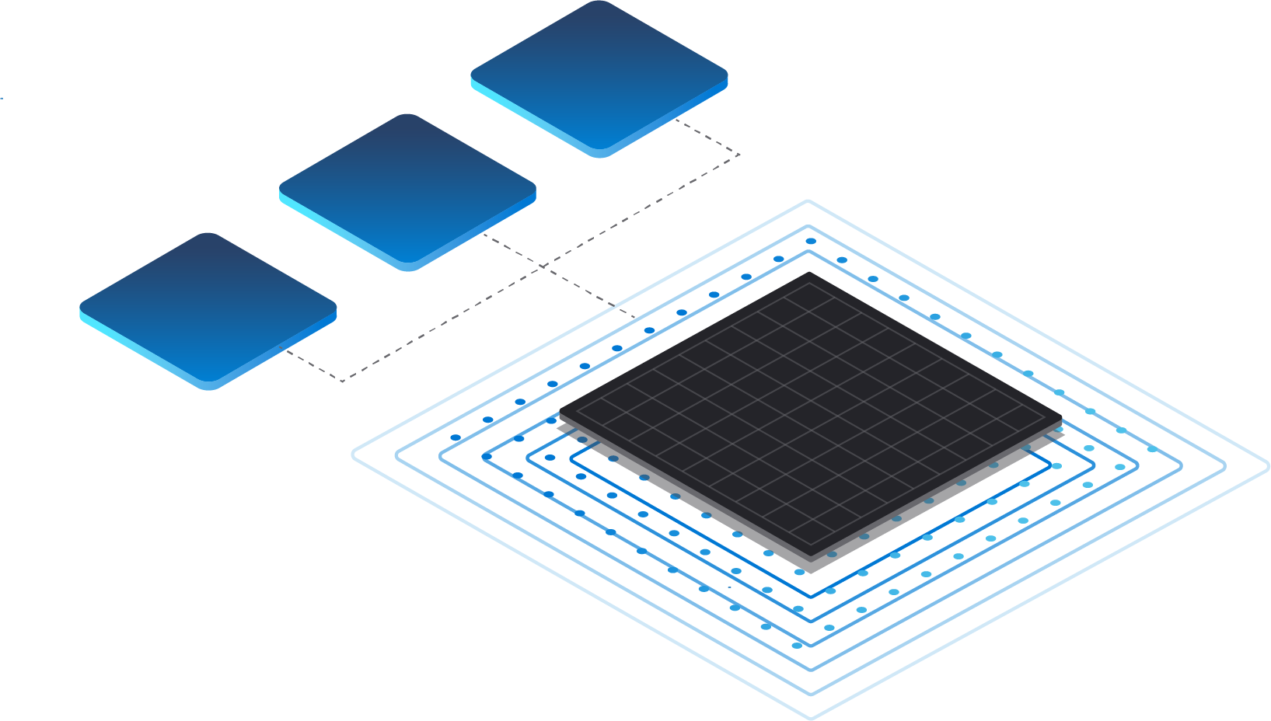

Microsoft Dataverse
Power Apps
Microsoft Dynamics 365
Dataverse—the common store for Microsoft business applications—is an analytics goldmine
Power
Automate
Notes:
As developers use platforms such as Power Apps, Power Automate, or Dynamics 365 to create business applications, the data that comes from these applications is massive. Today, customers store and manage this data in Dataverse—a common store for all Microsoft business applications.

Slide 4
Remove barriers between operational & analytics systems
Operational Databases
Analytic Databases
High throughput ingestion of both batch & streaming feeds with real-time indexing
Global distribution with active-active setup
Apps to perform real-time CRUD & queries using developer friendly NoSQL APIs
No downtime elastic scaling of database
SLAs for latency/availability/consistency/throughput
Run analytics without impacting operational performance
Low cost on storage and compute to run near-real time analytics workloads
Analyze in-place data, eliminating ETL complexity, with Synapse Spark and SQL
Rich BI ecosystem of SQL available for cheaper & faster queries over analytical storage
Native integration of Azure Enterprise AI ecosystem for training and scoring ML models over analytical storage

Slide 5
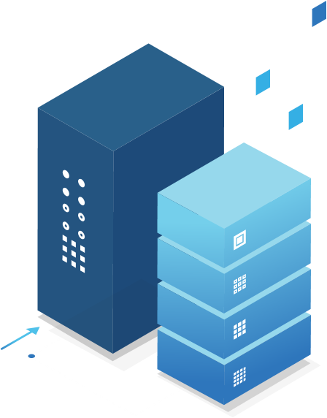
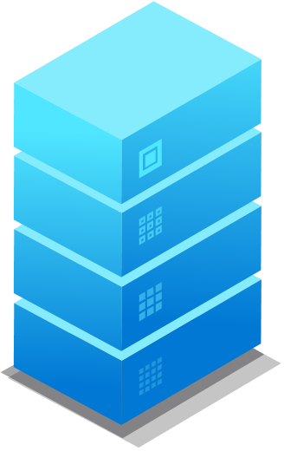





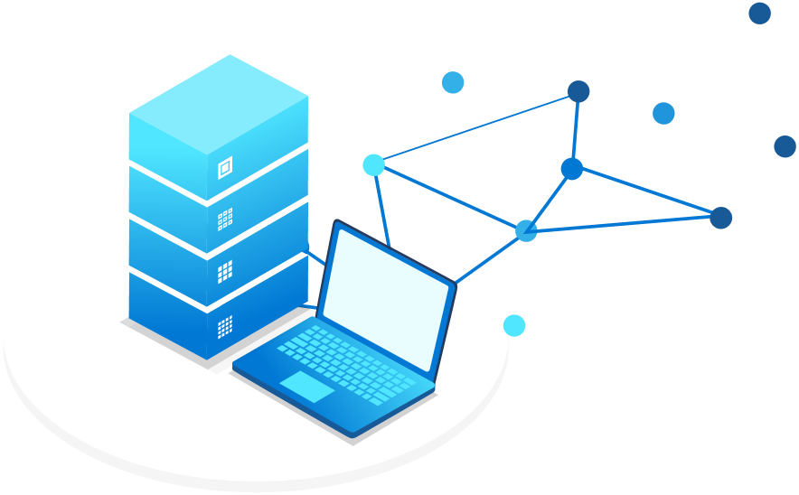
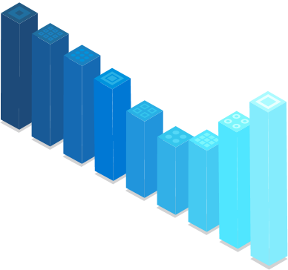
Preparing data to be analytics-ready requires various processes
Operational Databases
Relational Databases
EXTRACT
TRANSFORM
LOAD
Business Apps

Slide 6

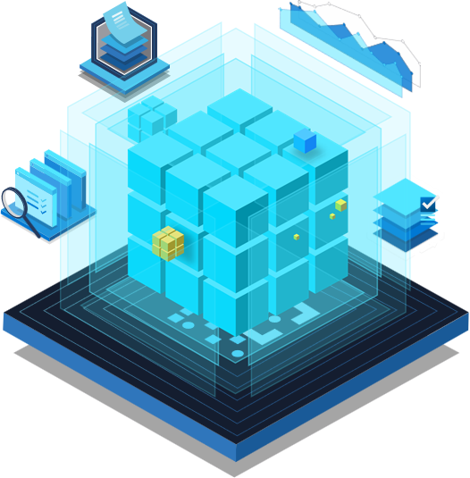
These processes result in additional issues that stall data insights
Operational Databases
Relational Databases
EXTRACT
TRANSFORM
Data Pipelines
LOAD
Analytics Destination
Business Apps

Slide 7
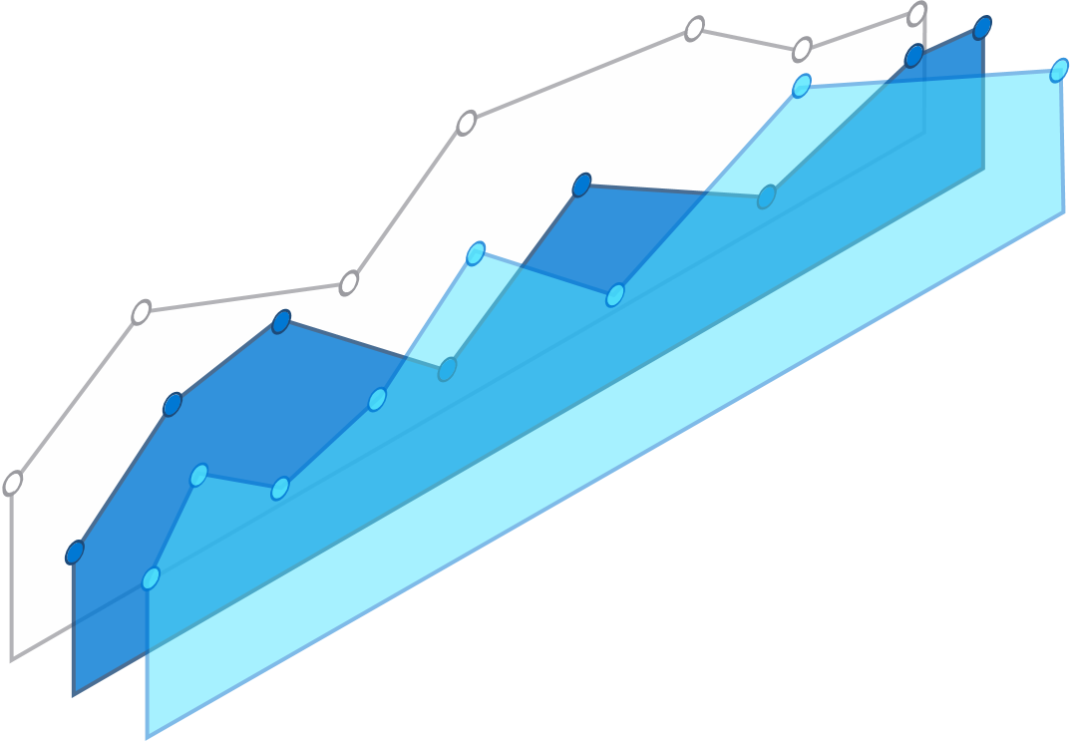
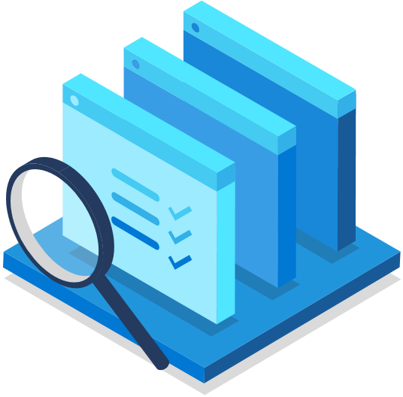




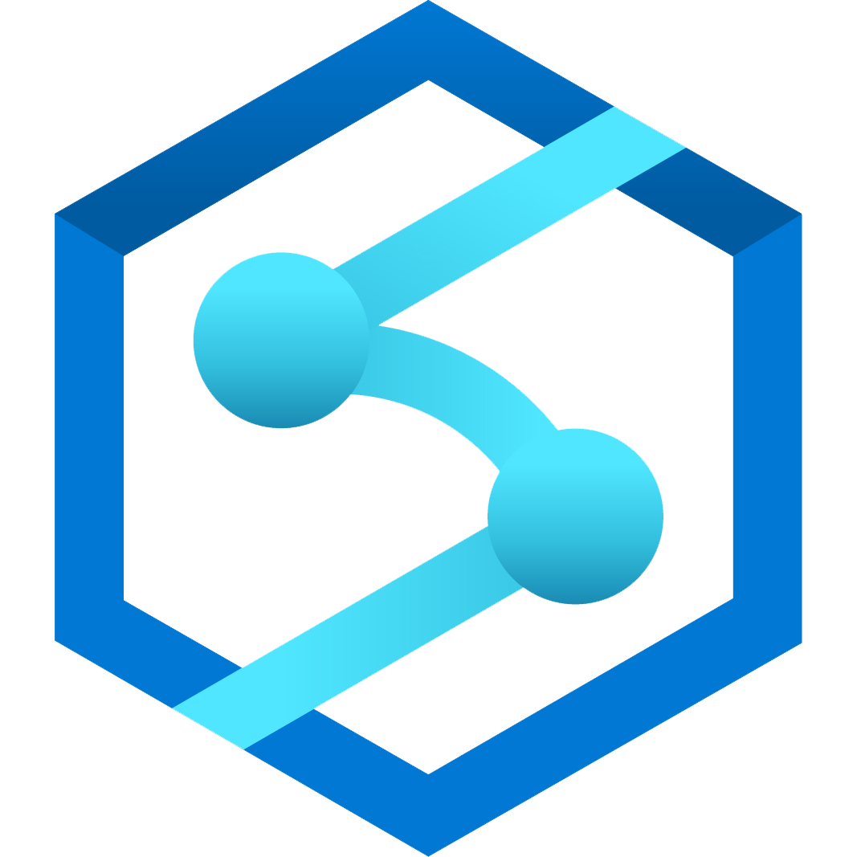
Azure Synapse Link
Azure Synapse Link
for Cosmos DB
Coming soon:
Azure Synapse Link
for SQL
Operational Databases
Relational Databases
No managed ETL
Built for convergence
Power BI
Near real-time analytics
Azure Synapse Link
for Dataverse
Azure Synapse Analytics
Business Apps
Notes:
No data integration pipelines required
Latency <90s at 99th percentile
Near real-time insights on transactional data with no performance impact
1-click experience for Power BI dashboard

Slide 8

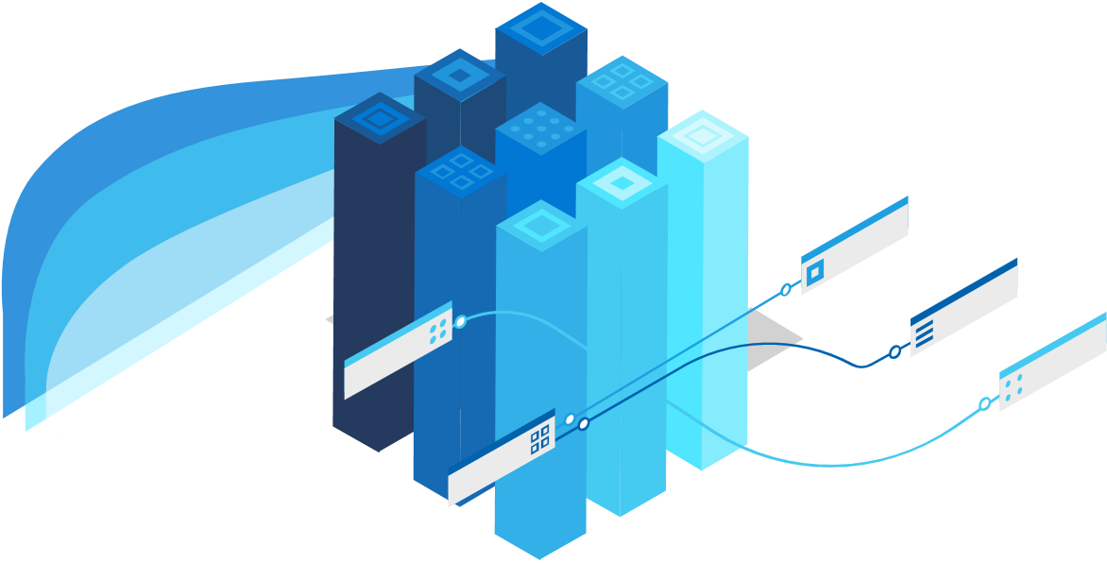

Azure Synapse Link for Dataverse
Power Apps
Microsoft Dynamics 365
Power
Automate
Analytics systems
Azure Synapse
Notes:
However, when customers want to discover deep insights from the data within Dataverse it requires stitching a multitude of services together. This creates a barrier between business applications data and analytical systems by constantly copying data back and forth. This is a critical factor that impedes accelerated time-to-insight and also results in constant maintenance and adjustments.

Slide 9

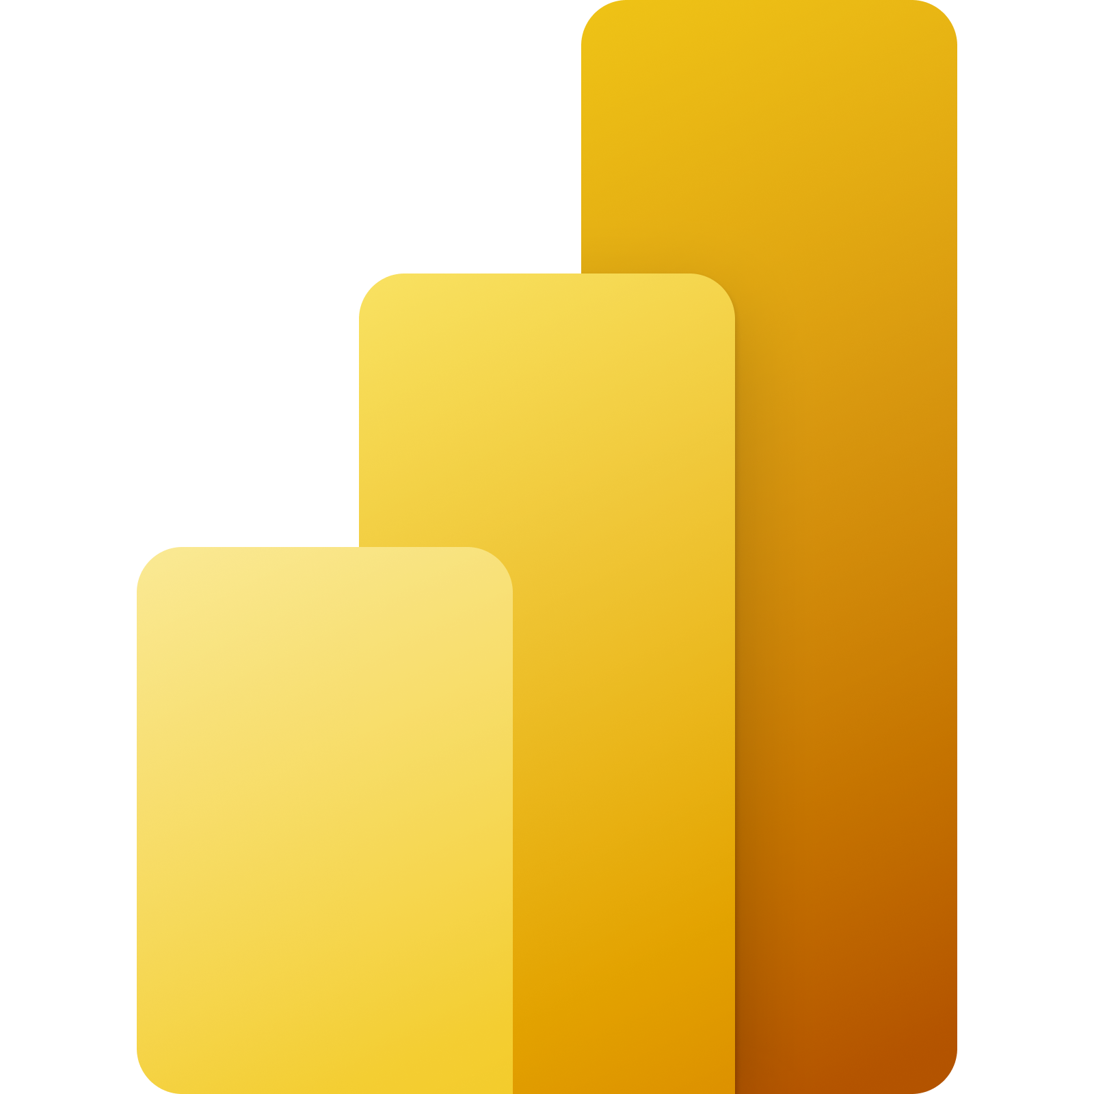
Azure Synapse Link for Dataverse
Power Automate
Power Apps
Microsoft Dynamics 365
Dataverse
Extended Analytics Possibilities
One Data Destination
Give Back Valuable Time
Reduce Costs
With a few clicks populate Dataverse data into Azure Synapse and enable data teams to discover deeper insights
Simplify access to data across multiple business units in a secure and compliant manner
Empower data teams to spend more time discovering and sharing insights than focusing on manual data tasks
Build a unified analytics solution that requires less data processes to make insights readily available

Slide 10

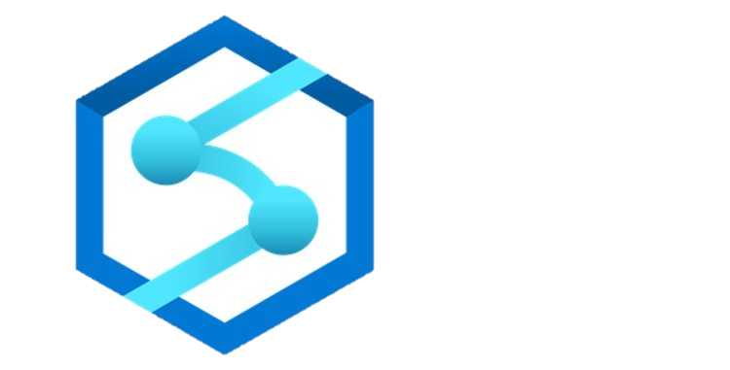
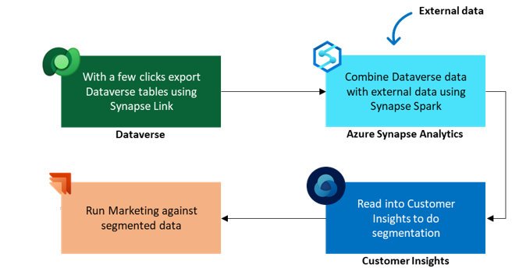

How are customers using Synapse Link for Dataverse?
Empowering Governments: Exporting and analyzing COVID-19 testing and vaccination data to keep communities informed and healthy.
Empowering Businesses: Nationwide landscaping company identifies their happiest and unhappiest customers.
With a few clicks export Dataverse tables using Synapse Link
With a few clicks export Dataverse tables using Synapse Link
Combine Dataverse data with external data using Synapse Spark
Dataverse
Dataverse
Azure Synapse Analytics
Dataverse data is transformed using Synapse Pipelines
Run Marketing against segmented data
Read into Customer Insights to do segmentation
Azure Synapse Analytics
COVID-19 Dashboard
Dataverse
Azure Synapse Analytics
Power BI

Slide 11
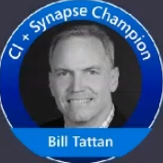
Demo: Azure Synapse Link for Dataverse
Azure Synapse Link
for Dataverse
Accelerate time to insight
With converged analytics
Demo Recording Link: Azure Synapse Link for Dataverse – Bill Tattan, Microsoft
GitHub Demo: GitHub - Azure/Test-Drive-Synapse-Link-For-DataVerse
Notes:
There are two demo options: watch the demo or perform the demo. Performing the demo requires specific setup steps.
Please find the demo prerequisites and steps at the following location:
Azure Synapse Link For Dataverse POC Environment Setup
This deployment package allows the user to deploy a Proof-of-Concept environment of Azure Synapse Analytics link for Dataverse with spark notebook to (ingest, merge, aggregate and transform) dataset.
1-Prerequisites
1-If you are an internal Microsoft employee, you must complete the prerequisites in this Internal Guide before proceeding to next steps.
2-Owner role (or Contributor roles) for the Azure Subscription is required to deploy the template. This is for creation of a separate Proof-of-Concept Resource Group and to delegate roles necessary for this proof of concept.How To Assign Azure Role.Refer to this official documentation for more details on RBAC role-assignments.

Slide 12
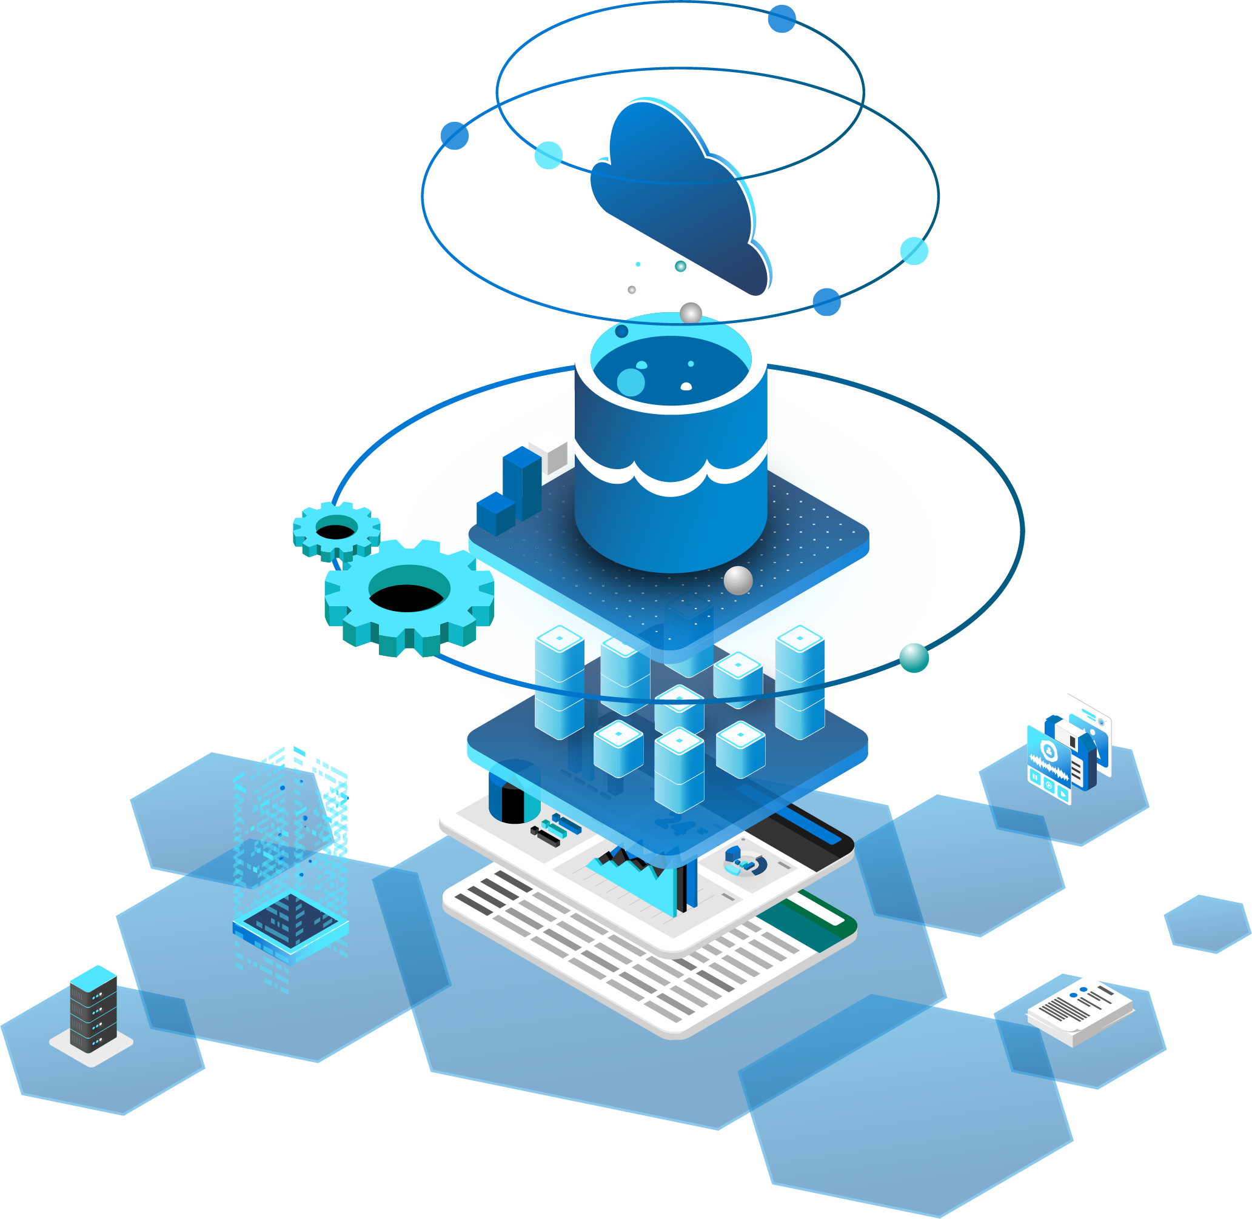
Empower every data store to be analytics-ready
Data Movement
Bring the power of analytics to every data team across your business without increasing ETL tasks
Complete View of Your Business
Easily connect separate systems that collect and store data with a one-click experience
Real-time BI Reporting
Create instant clarity across various business units and enable real-time insights
Future Proof Your Analytics Solution
Implement a solution that intentionally builds automated connections to ease IT burdens and accelerate time-to-insight

Slide 13
Enable Azure Synapse Link for converged analytics
Understand the benefits of Analytics for operational databases
Create a Synapse workspace and connect it with your Dataverse data
Leverage Synapse Link for near real-time data analysis

Slide 14
Thank you

Slide 15
Appendix

Slide 16
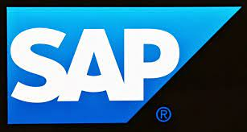



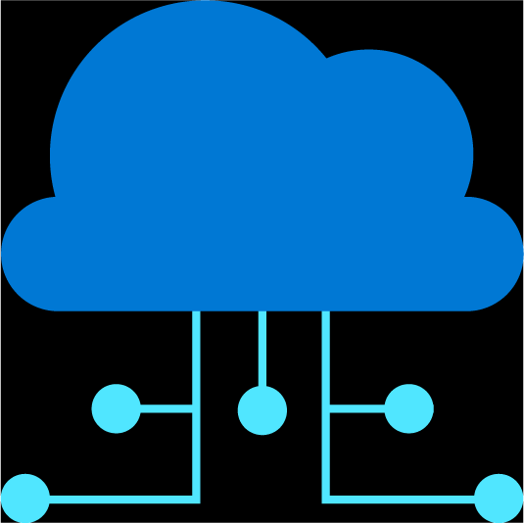




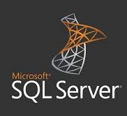

Azure Synapse
Create a single architecture foundation
Single system to reduce the burden for multiple systems
Right analytics engine for the right data at any scale
Security and governance
One-click experience for converged analytics
Relational
Big Data
Log Analytics
Any data, any format
Published
Curated
Raw
Notes:
Azure Synapse provided multiple best-of-breed analytics runtimes which enabled customers to simply do more with less.
As opposed to limiting customers only to a SQL engine which is optimized for some scenario, Synapse provides SQL, Spark, and Log Analytics engines within a single integrated development environment.
Purpose built engines optimized for different scenarios enable customers to yield more insights faster and with fewer resources and less cost. Budgets go further, deeper insights are unlocked, and customers who a multi-engine approach to analytics can outperform their competitors by making better, more informed decisions.
From an enterprise warehouse to domain-based architecture
Many data-architecture leaders have pivoted from a central enterprise data lake toward “domain-driven” designs that can be customized and “fit for purpose” to improve time to market of new data products and services. With this approach, while the data sets may still reside on the same physical platform, “product owners” in each business domain (for example, marketing, sales, manufacturing, and so on) are tasked with organizing their data sets in an easily consumable way both for users within their domain and for downstream data consumers in other business domains. This approach requires a careful balance to avoid becoming fragmented and inefficient, but in return it can reduce the time spent up front on building new data models into the lake, often from months to just days, and can be a simpler and more effective choice when mirroring a federated business structure or adhering to regulatory limitations on data mobility.
One European telecommunications provider used a distributed domain-based architecture so sales and operations staff could expose customer, order, and billing data to data scientists for use in AI models or directly to customers via digital channels. Rather than building one central data platform, the organization deployed logical platforms that are managed by product owners within the company’s sales and operations teams. Product owners are incentivized to promote the use of the data for analytics and are using digital channels as well as forums and hackathons to drive adoption.
Enabling concepts and components
Data infrastructure as a platform provides common tools and capabilities for storage and management to speed implementation and remove from data producers the burden of building their own data-asset platform.
Data virtualization techniques, which started in niche areas such as customer data, are now being used across enterprises to organize access to and integrate distributed data assets.
Data cataloging tools provide enterprise search and exploration of data without requiring full access or preparation. The catalog also typically provides metadata definitions and an end-to-end interface to simplify access to data assets.

Slide 17
Dataverse
Power Apps
Microsoft Dynamics 365
Dataverse—the common store for Microsoft business applications—is a data insights goldmine
Power
Automate
Notes:
As developers use platforms such as Power Apps, Power Automate, or Dynamics 365 to create business applications, the data that comes from these applications is massive. Today, customers store and manage this data in Dataverse—a common store for all Microsoft business applications.

Slide 18
Dataverse
Power Apps
Microsoft Dynamics 365
However, performing advanced analytics on business apps data is tedious and complex
Power
Automate
Analytics systems
Azure Synapse
Notes:
However, when customers want to discover deep insights from the data within Dataverse it requires stitching a multitude of services together. This creates a barrier between business applications data and analytical systems by constantly copying data back and forth. This is a critical factor that impedes accelerated time-to-insight and also results in constant maintenance and adjustments.

Slide 19
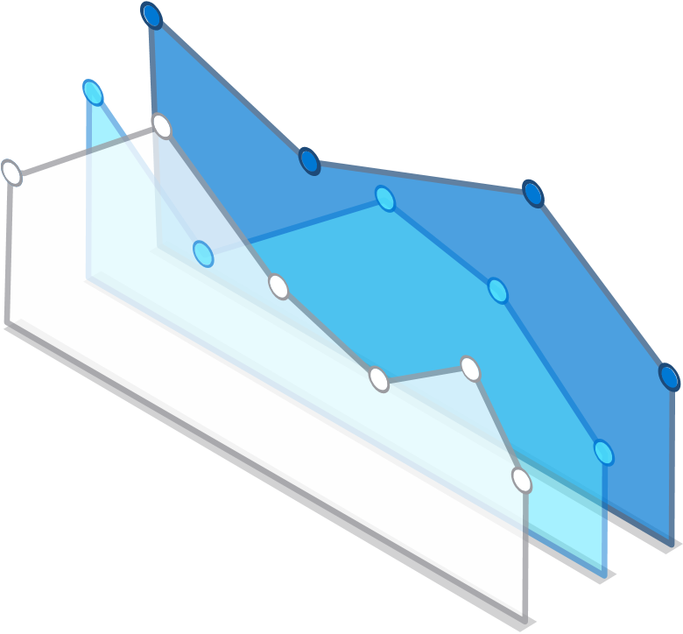
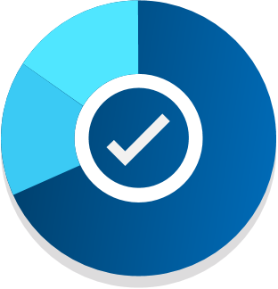
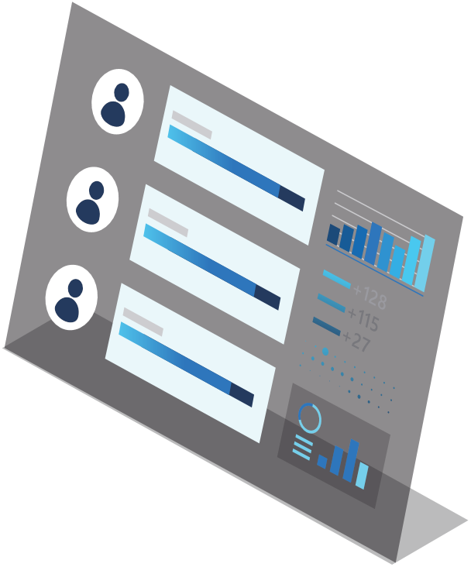
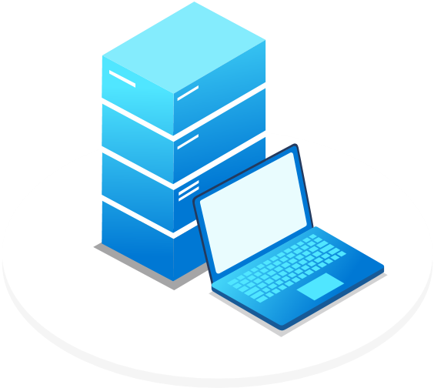
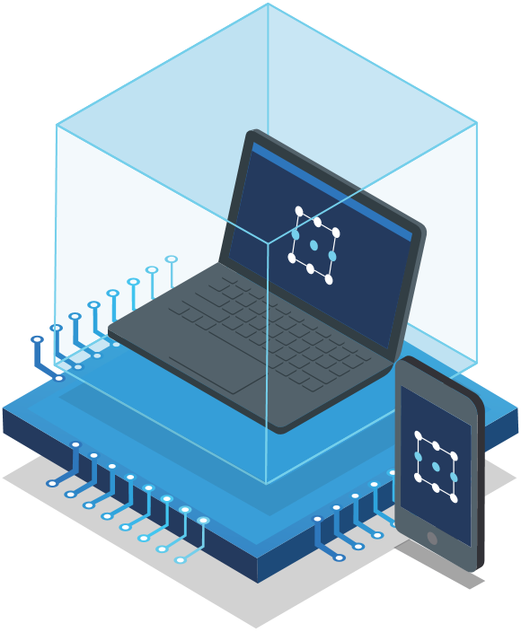


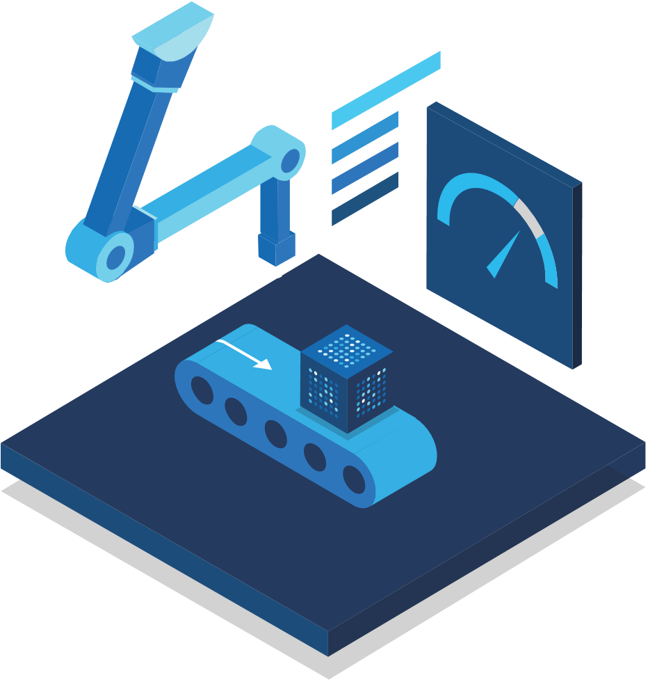
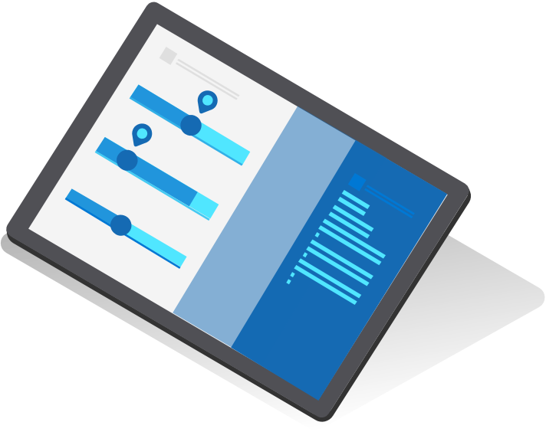

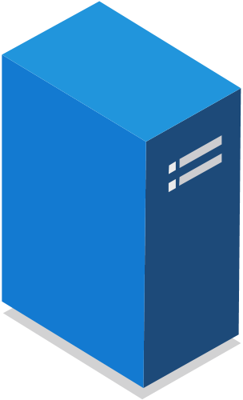
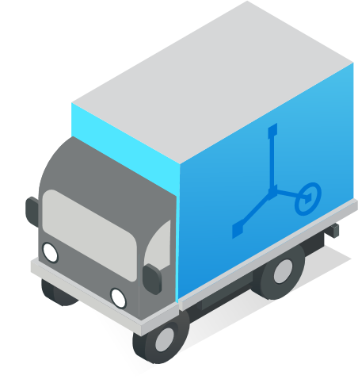

Operational Analytics Powers Intelligent Manufacturing
Remote Asset Monitoring
Predictive Maintenance
Supply Chain Optimization
Real-time insights on IoT and equipment health and performance.
Maximize efficiency, improve quality production, and eliminated unplanned downtime.
Automate an end-to-end view of your supply chain and business.

Slide 20

Moving from a linear supply chain to a network-oriented supply chain
Analog Today
Digital Future
Plan
Customer
!
!
!
!
Service
Engineering
Digital Platform
Specifications
Recipes
Formulations
Packaging
Conditions
!
!
Logistics & Distribution
Manufacturing
Design
Make
!
Assemble
Deliver
Support
Assembly packaging
Long lead times, low schedule compliance
and lost productivity
High service levels, cost optimized
and dynamically responsive
Disconnected processes
Layered planning
Reactive execution
Excess Inventory
Orchestrated processes
Insight driven
Predictive operations
Closed loop end-to-end

Slide 21
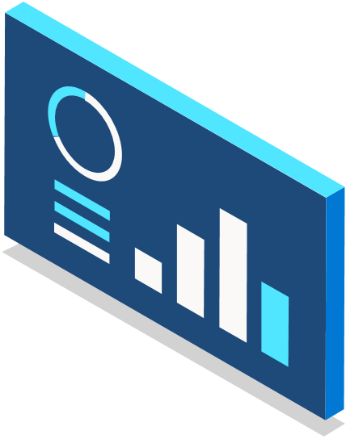

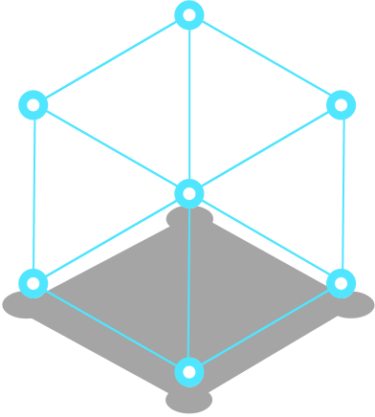







Business outcomes of Supply Chain Optimization
A
B
Better demand forecasting and customer satisfaction
Agility and resiliency throughout the supply chain
Optimized inventory and planning delivery costs
Increased sustainability and waste reduction
Customer’s increasingly complex demands require manufacturers to better predict demand consumption habits and external economic indicators, to drive satisfaction, loyalty and retention.
Manufacturers gain the ability to quickly and efficiently respond to disruptions using what-if scenario analysis that relies on real-time data. With cognitive sourcing manufacturers also gain a view of optimal procurement.
Optimized supply chains with increased visibility opens doors for lower sourcing, inventory and delivery costs while not reducing service levels.
Eliminate waste by making data-driven decisions that provide a forecast of the most efficient resolutions to issues at any given time.

Slide 22
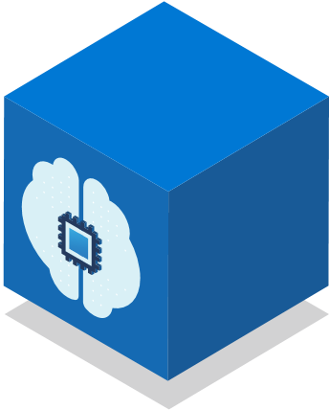


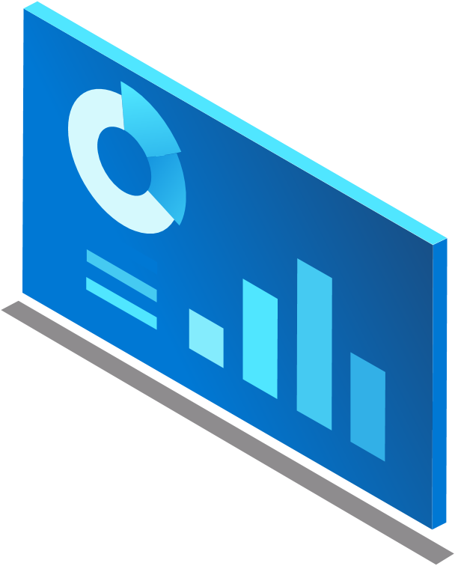


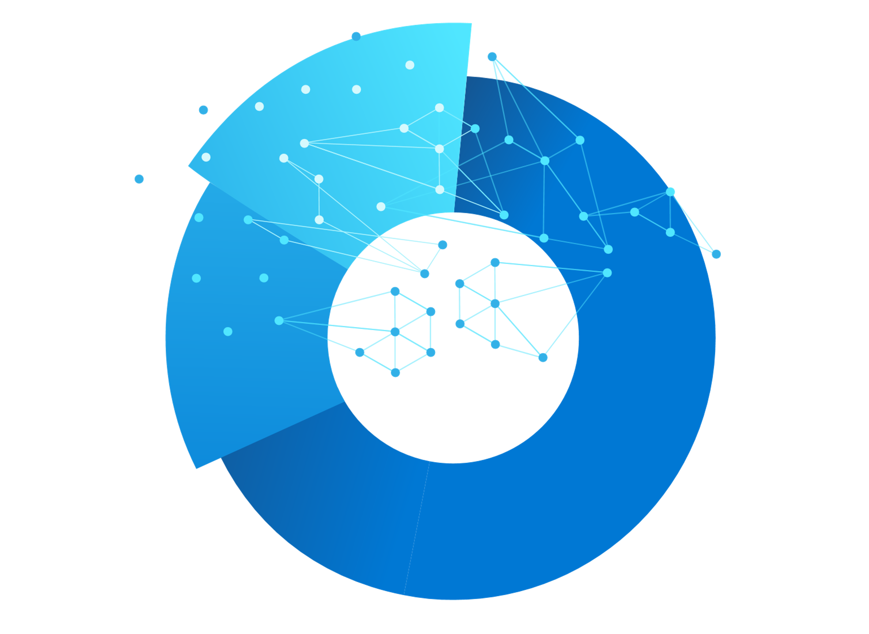
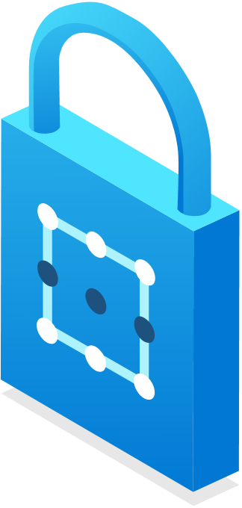
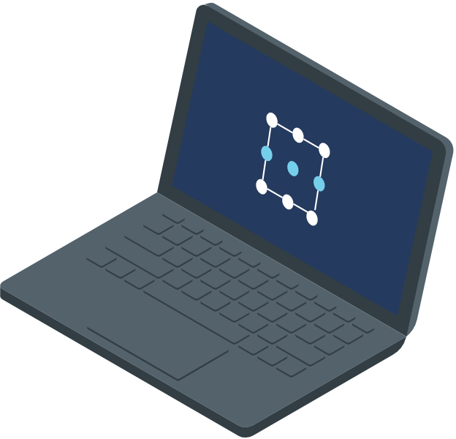
Operational Analytics Powers Intelligent Retail
Know Your Customer
Resilient Supply Chain
Fraud Detection
Deliver personalized experiences across all channels.
Aggregate real-time information across your supply chain and improve merchandising decisions.
Bring fraud detection tools out of siloes and seamlessly apply them across channels and systems.

Slide 23
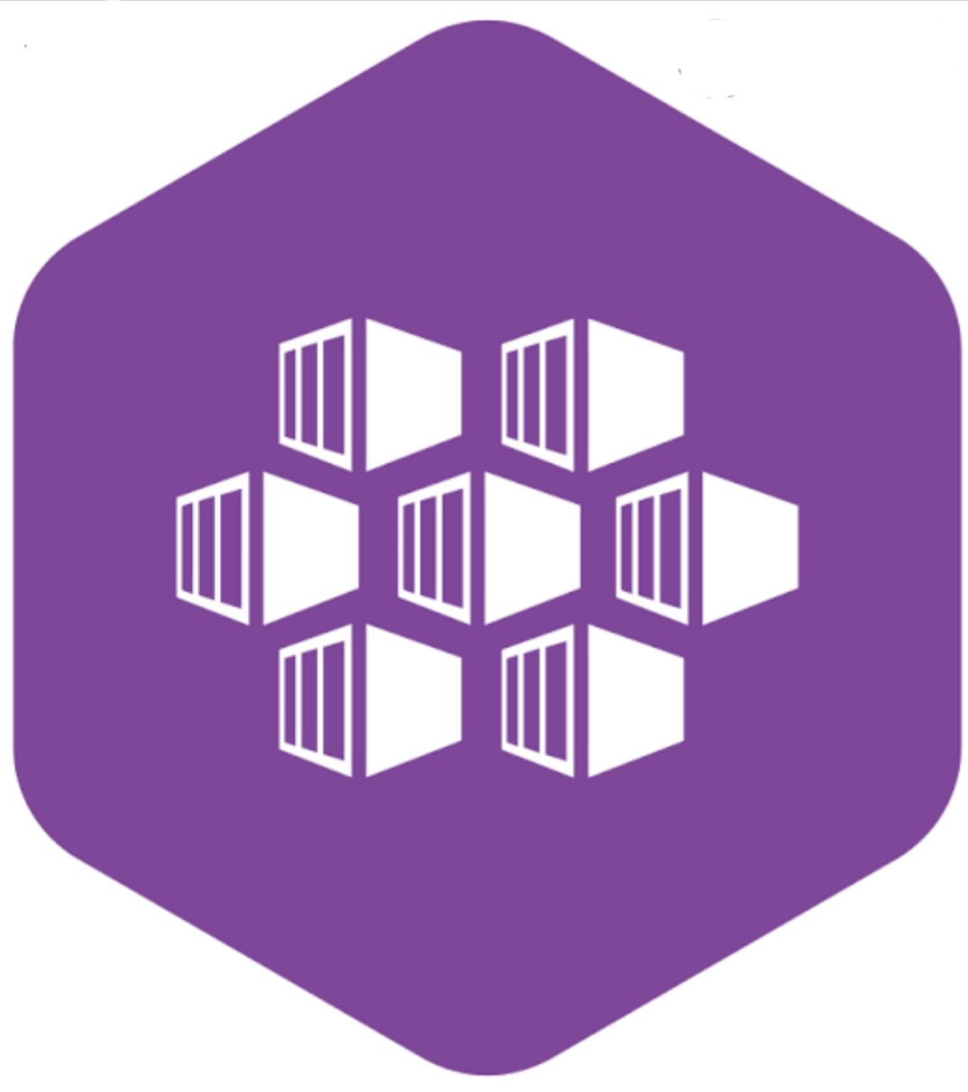





Know Your Customers with Real-time Personalization
Azure Kubernetes Service (Recommendations API)
Azure Active Directory B2C
Online recommendation service
Azure Cosmos DB
Azure Synapse (Spark processing pipeline)
{
{
{
Shoppers
Web App (e-commerce store)
{
API app (Order processing API)
Transactional
Analytical
Online order processing service

Slide 24

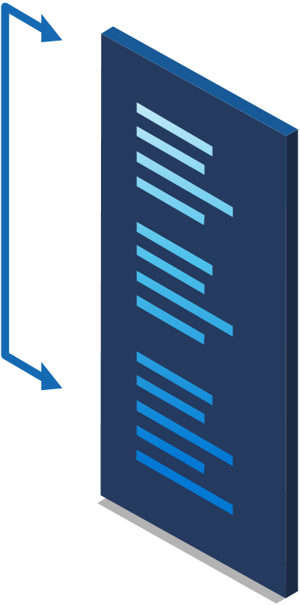
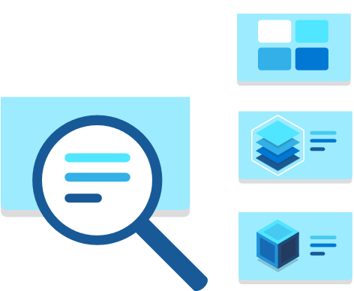

Business outcomes of Real-time Personalization
360-degree of customer
Targeted marketing for each customer segment
Predict end-user experience
Link multiple customer accounts from multiple systems to create a single source of truth and deeply understand customer personas
Drive more relevant offers and recommendations to grow revenue and improve customer experience
Discover meaningful patterns and develop actionable strategies to monetize them

Slide 25
Business Architecture: Supply Chain Optimization
Analytics Outputs
POS Transactions
Online/Mobile Purchases
Social Media Sentiment Analytics
Device/Sensor IoT Data
(beacons, cameras)
Supply Chain + Warehouse Operations Data
Azure Synapse Link
Contract cycle optimization
Collect & Ingest
Available-to-promise
Price-elasticity analysis
Unify a range of analytics across systems, and perform complex query on operational and transactional factory data at rapid scale
Route planning and scheduling
Demand forecasting
Massively scalable, secure data lake store for big data removing your data silos
Azure Data Lake Storage
Notes:
Business architectures –are talk tracks and ways to engage the customers
Driving business-level discussions, and not just leading the technology
Again we have all of our data sources on the left which are different operational systems feeding a supply chain
We ingest this data and
We use Azure Synapse as our Analytics engine to accelerate insights that are actionable for the business and drive outcomes
Lastly we can visualize the data to empower the entire business
Outcomes we are driving:
Gain full visibility into supply chains
Optimize the supply chain to exceed customers’ expectations.
Intelligent supply chain enables businesses to better serve their customers in numerous ways.
Retailers can detect trend signals from customers’ browsing and post-purchase behavior and execute real-time changes in merchandising decisions.
With an updated analytics platform, the business can, aggregate real-time information throughout the supply chain and fulfillment process flows and make business decisions on-the-fly
Eliminating common data silos and integrating analytics across the supply chain increases supplier collaboration by sharing of inventory data and delivery plans.
With an intelligent supply chain, companies can save on costs, earn more revenue, increase their speed to customer, and get ahead of their competition.
These solutions utilize big data, customer behavior, and business trends to inform and optimize the entire digital supply chain. → drive operational efficiencies

Slide 26
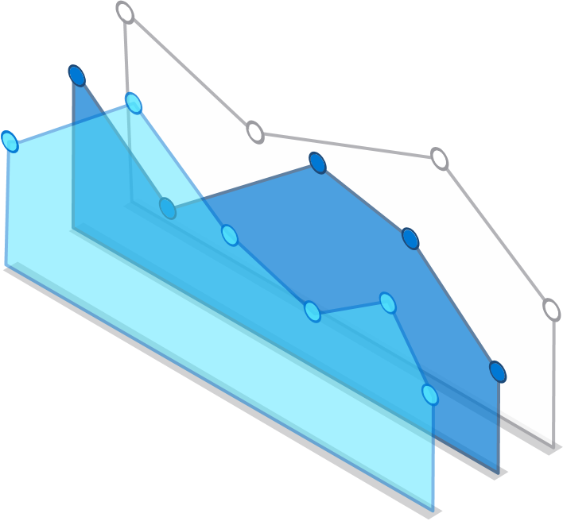

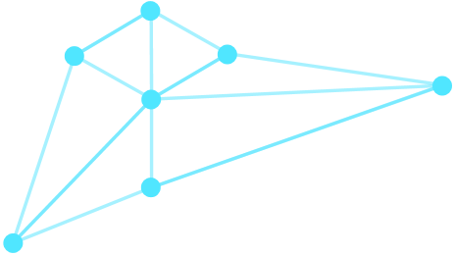
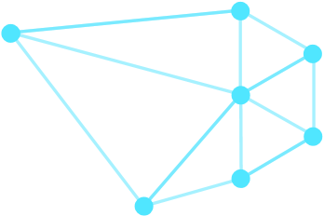


Business outcomes of Supply Chain Optimization
Increase Operational Efficiencies
Reduce Costs
Optimize Performance
Get a unified view of your business and leverage to optimize existing processes and turn operational data into actionable insights through data, analytics, AI, and visualization tools.
Reduce upfront capital investment and operations costs with nearly unlimited on-demand capacity, where focus can be placed on improving business operations and differentiating the supply chain.
Build a modernized data environment that collects information from siloed sources, creating a single source of truth and bridging the gap between systems to provide a complete picture the entire supply chain.
Benefits

Slide 27
Business Architecture: Fraud Detection
Near Real-time Transactions
Azure Synapse Link
Near Real-time Activity (logs etc.)
Visualize your data
Authentication
Protect / Anonymize
Collect & Ingest
Analyze your data
Customer / Product holding data
Prep, experiment, deploy models
Match customers across sources. Real-time customer profile updates – transaction averages, counts per period, and more
External data
Stream
Embed predictive models
Massively scalable, secure data lake store for big data removing your data silos
Azure Data Lake Storage

Slide 28





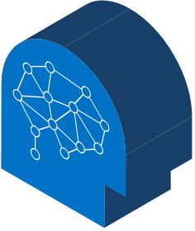


Business Outcomes of Fraud Detection
Deliver New Services
Cut Losses & Investigation Time
Reduce Customer Friction
Speed up Detection
Provide new services to customers, helping them save costs by applying machine learning and advanced analytics to detect fraudulent transactions.
Use more data and advanced detection models to improve detection and deliver better insights to case workers.
Reduce false positives and minimize customer inconvenience. Tailor post-detection actions to customer needs and automate.
Meet the needs of real-time payment schemes by reviewing transactions and continuously refreshed customer profiles in milliseconds.

Slide 29


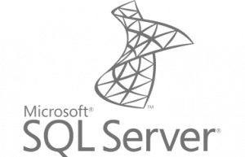
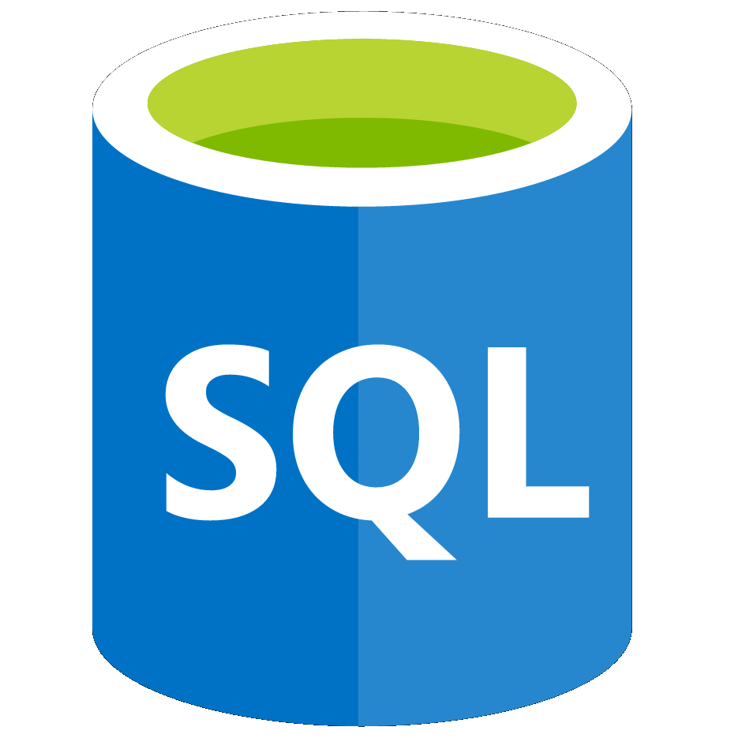
Azure Synapse Link
Real-time insights & BI reporting
Operational Systems
Analytics Systems
Power Automate
Power Apps
Power BI
No data integration pipelines required
Latency <90s at 99th percentile
Near real-time insights on transactional data with no performance impact
1-click experience for Power BI dashboard
Microsoft Dynamics 365
Synapse Link for Microsoft Dataverse
Dataverse
Business Applications
Operational Databases
*Synapse Link for SQL server
(COMING SOON)
*
*
*Coming Soon

Slide 30
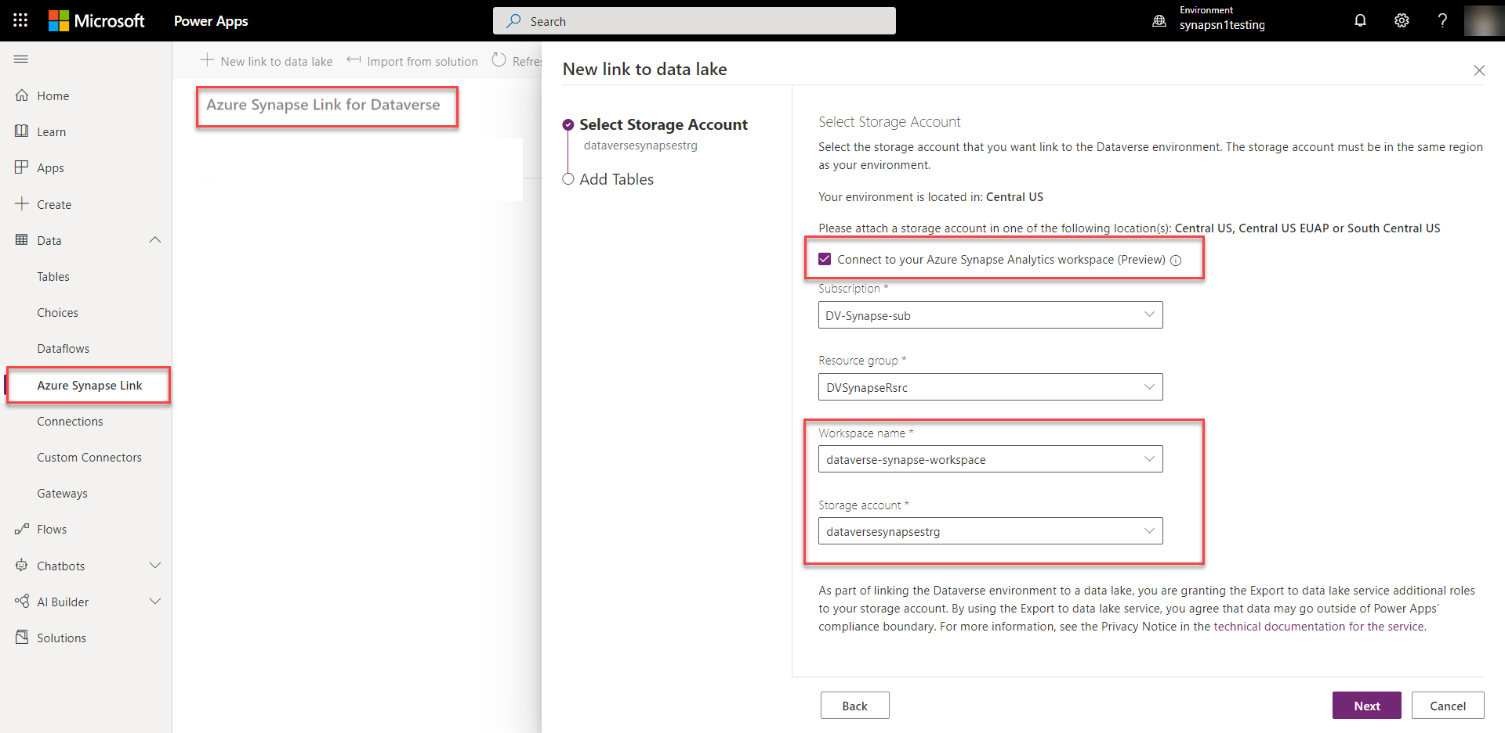
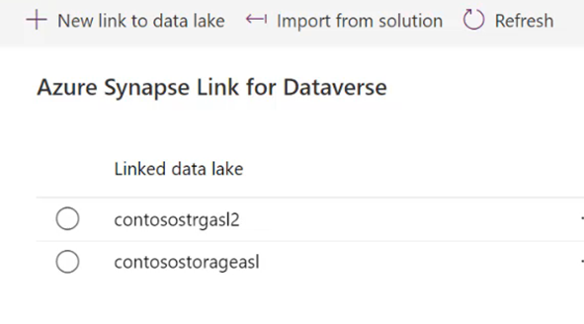

Process of adding link to data lake
1 CLICK
LINK SETUP!
Notes:
Developers working in Power Apps or Dynamics 365 can bring their entire Dataverse environment to Azure Synapse. Simply click a button, enter the Synapse workspace for a seamless experience. Developers don’t leave the Power Apps or Dynamics 365 portal to get to Azure Synapse. Click “go to Azure Synapse workspace” and begin discovering insights with an end-to-end analytics service.

Slide 31

Azure Synapse Link for Dataverse
Notes:
https://microsoft-my.sharepoint.com/:v:/p/mmittal/EYe-dFDgLUBPogT4sqYy_XoBBn0aaaLxoKiilSSVeMhUtw?e=E72DGF

